Slide 1
PrEP or Peril: rolling out PrEP in the private sector without subsidy or government support
Donn Colby, Mathurada Kongkabpan, Somsong Teeratakulpisarn, Nipat Teeratakulpisarn, Chanjiraporn Pondet, Charnwit Pakam, Prapaipan Plodkratok, Tarandeep Anand, Praphan Phanuphak, Nittaya Phanuphak
Amsterdam, Netherlands
26 July 2018

Slide 2
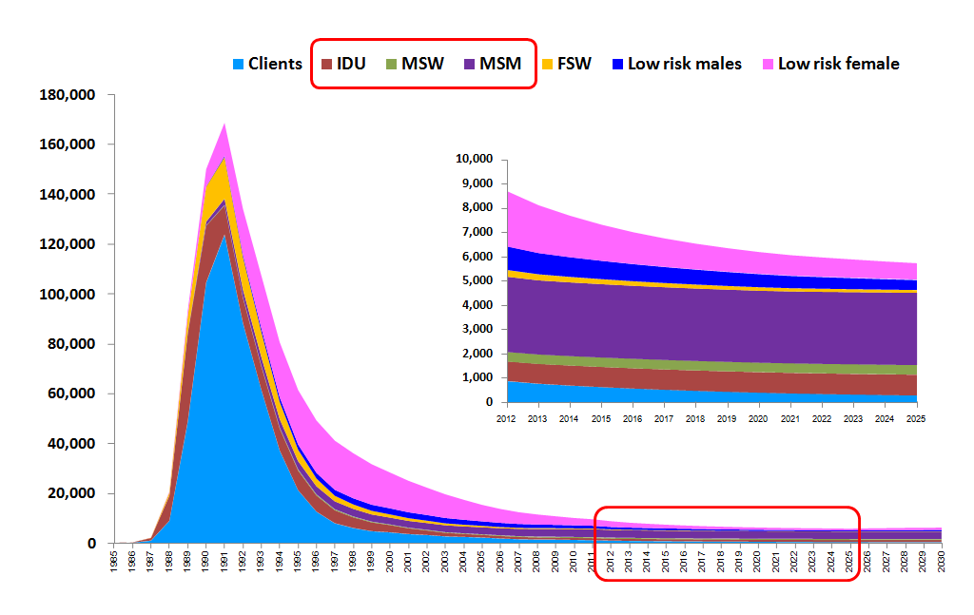
The number of new HIV Infections in Thailand is decreasing every year..

Slide 3
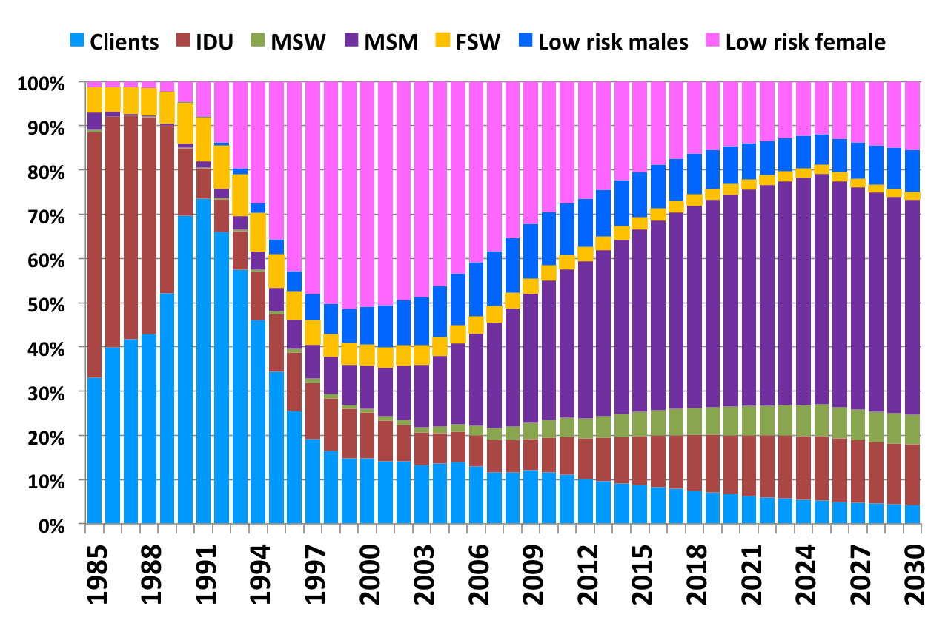
But new infections among MSM are increasing
59%
54%
47%
35%
20%
10%
6%
AIDS Epidemic Model Projections for HIV/AIDS in Thailand: 2010-2030.

Slide 5
The Anonymous Clinic at the Thai Red Cross AIDS Research Centre
The largest VCT in Thailand with over 35,000 HIV tests per year
Situation in 2014:
MSM HIV prevalence was 20%
Non-MSM HIV prevalence is 6%
MSM were 30% of clients, but were 90% of all acute HIV infections detected.

Slide 6
Check list of needs to start PrEP service
Human resources
Prescriber (MD or nurse)
HIV testing counselor
Pharmacist
Phlebotomist (blood draw)
Laboratory services
HIV antibody testing
Creatinine (kidney function)
HBsAg (hepatitis B)
Optional: STI testing, anti-HBs
Pharmacy services
PrEP drug (TDF/FTC)
Preparation
Protocol
Staff training

Slide 7
PrEP-30 at the TRC Anonymous Clinic
Launched December 2014 as the first publicly available PrEP service in Thailand outside of a clinical trial
Fee-based: Total cost 30 THB (<US$1) per day
Established in an existing VCT/ART clinic using current staff and clinic facilities
Simple protocol for VCT counselors to screen for “at-risk” clients, introduce PrEP to clients, and refer to doctor if PrEP indicated and client agrees
PrEP provided at first visit, after HIV test with negative result

Slide 8
PrEP-30 clients: new clients/month
New PrEP Clients (n)
Colby et. al., Thai Red Cross AIDS Research Centre

Slide 9
PrEP-30 clients: cumulative number
PrEP Clients (n)
Colby et. al., Thai Red Cross AIDS Research Centre

Slide 10
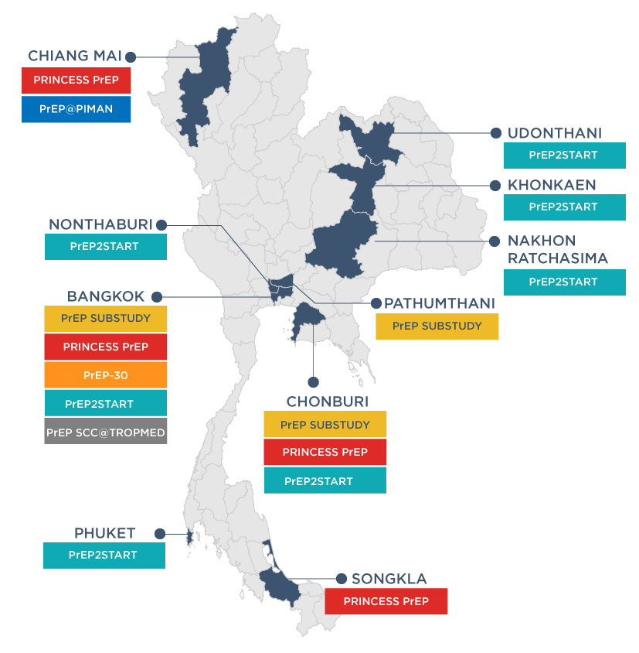
Thailand’s PrEP Programs, as of June 2018
PrEP Implementation Research
N = 700
Facility-based PrEP by MOPH and BMA
N = 540
USAID LINKAGES
and CDC KPIS funds,
Silom, Piman
Fee-for-Service PrEP
N = 4,500 (including non-Thai)
Key Population-Led PrEP (Princess PrEP)
N = 2,500
PULSE CLINIC
USAID LINKAGES and
TRCARC funds
Source: Estimated number of PrEP users in Thailand by June 2018 (courtesy of each program leader)
Notes:
.

Slide 11
Thailand’s PrEP Programs
KP-Led
Princess PrEP
Fee-based PrEP-30
Source: Estimated number of PrEP users in Thailand by June 2018 (courtesy of each program leader)

Slide 12
Lessons Learned
PrEP programs can be started quickly using existing facilities and staff.
MSM and other high-risk individuals are willing to pay for PrEP if delivered at an affordable price.
Low-cost generic PrEP is available in Thailand and from Indian generics for ~$20 USD/month
Fee-based PrEP remains an important resource for PrEP availability even as free PrEP delivery through public programs is scaled up

Slide 13
Acknowledgements
Thank you to organizations that supplied data for this presentation:
Prevention Department, Thai Red Cross AIDS Research Centre
USAID/LINKAGES Thailand Project

